Slide 1
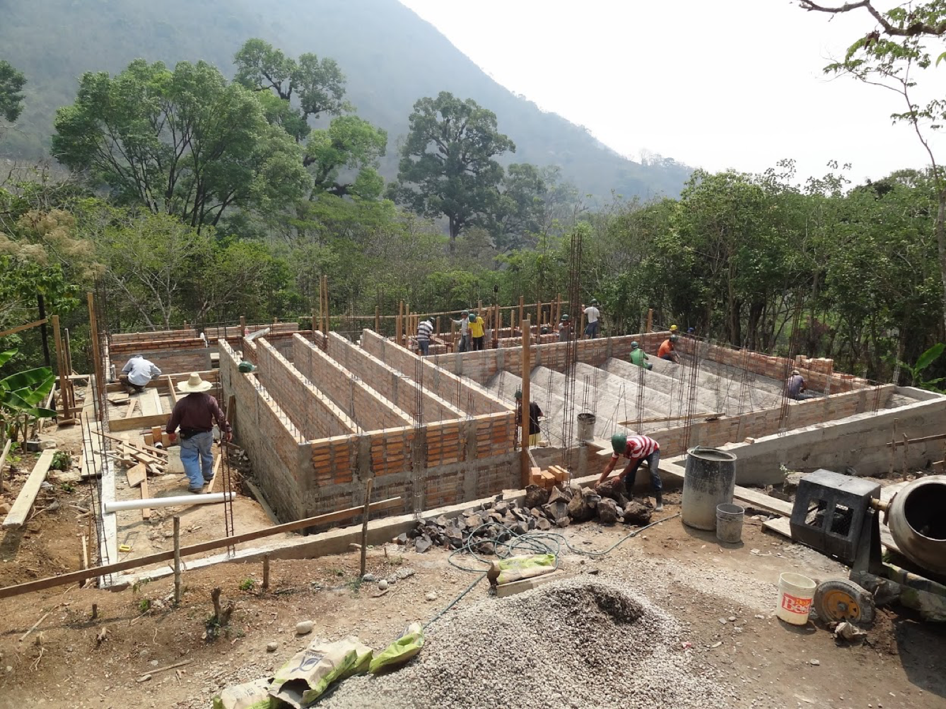
Sedimentation Tank Channels Design
H2Flows: Mehrin Selimgir, Linping Xu, Shuo Han
Notes:
Hi everybody, today we’re going to present our project on the design of sedimentation tank channels.

Slide 2
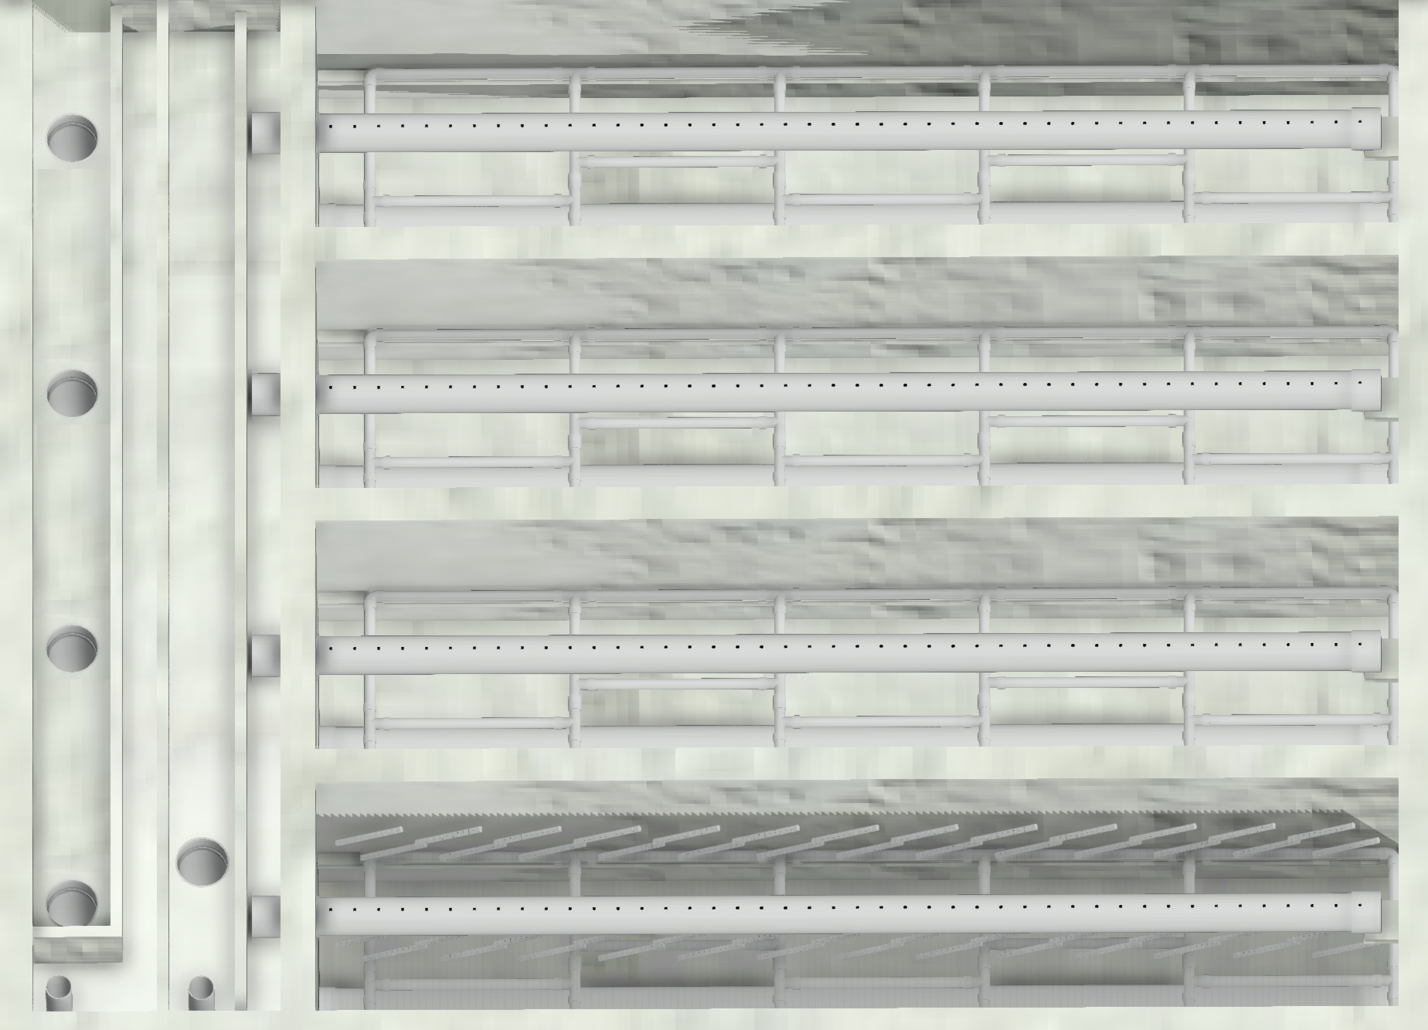
Introduction
Develop four-channel design algorithms in Python:
Old MathCAD codes
AIDE Design tools
Hydraulic equations for open channels
Quickly responding model.
Notes:
Our goal is to develop four-channel design algorithms in Python using..
The delivery of our project..

Slide 3
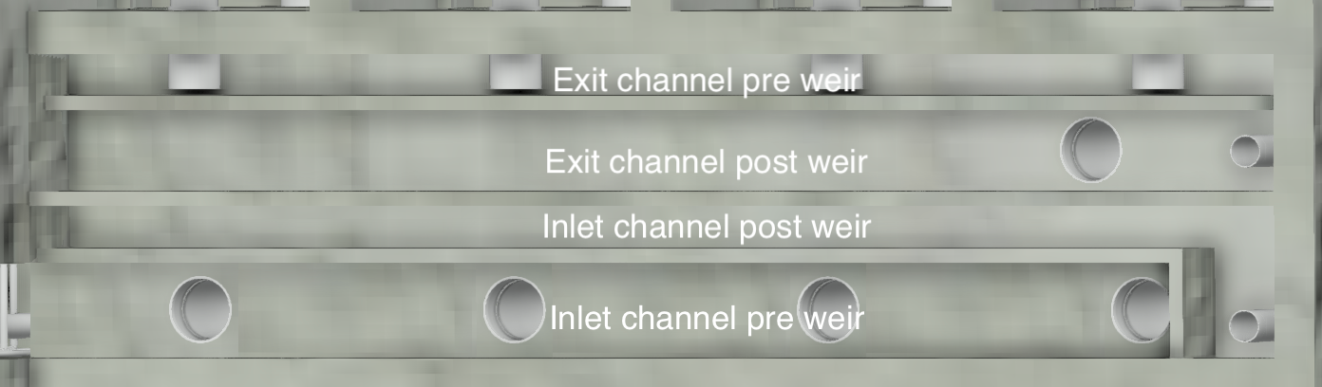
Introduction
Effluent
Poor flocculated water
Influent
Notes:
So the four channels are:

Slide 4
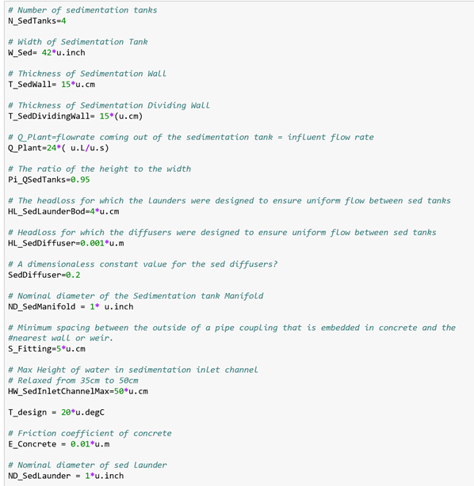
Design Constraints
•Sedimentation Tank
- Design for varying Q_plant = 6:60 L/s
•Inlet Channel
-Velocity of flocs in inlet channel don’t drop below 0.15 m/s
•Expert Input Values

Slide 5
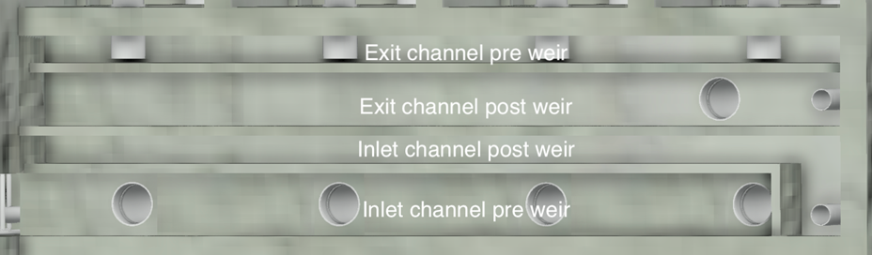
Governing Constraints of 4 Channels
•Inlet Channel Pre Weir
- width of channel constrained by headloss in inlet channel
•Inlet Channel Post Weir
-width of channel constrained by headloss and critical depth
•Exit Channel Pre Weir
- width of channel constrained by minimum channel width (15cm)
• Exit Channel Post Weir
-width of channel constrained by headloss in inlet channel

Slide 6
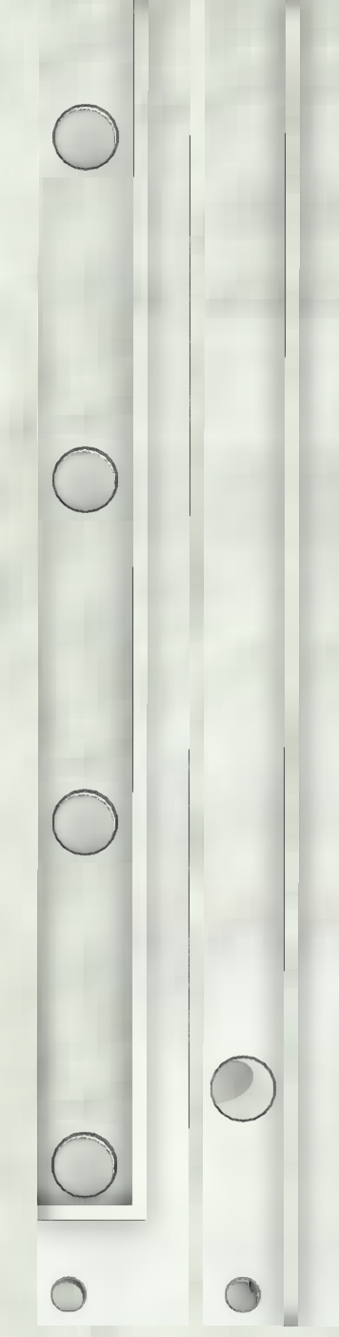


Design Algorithm
Width of sed tank
H2Flows Algorithm
KMinor
Expert Inputs
Flow rate
Or
1% Inspiration
99% Perspiration

Slide 7
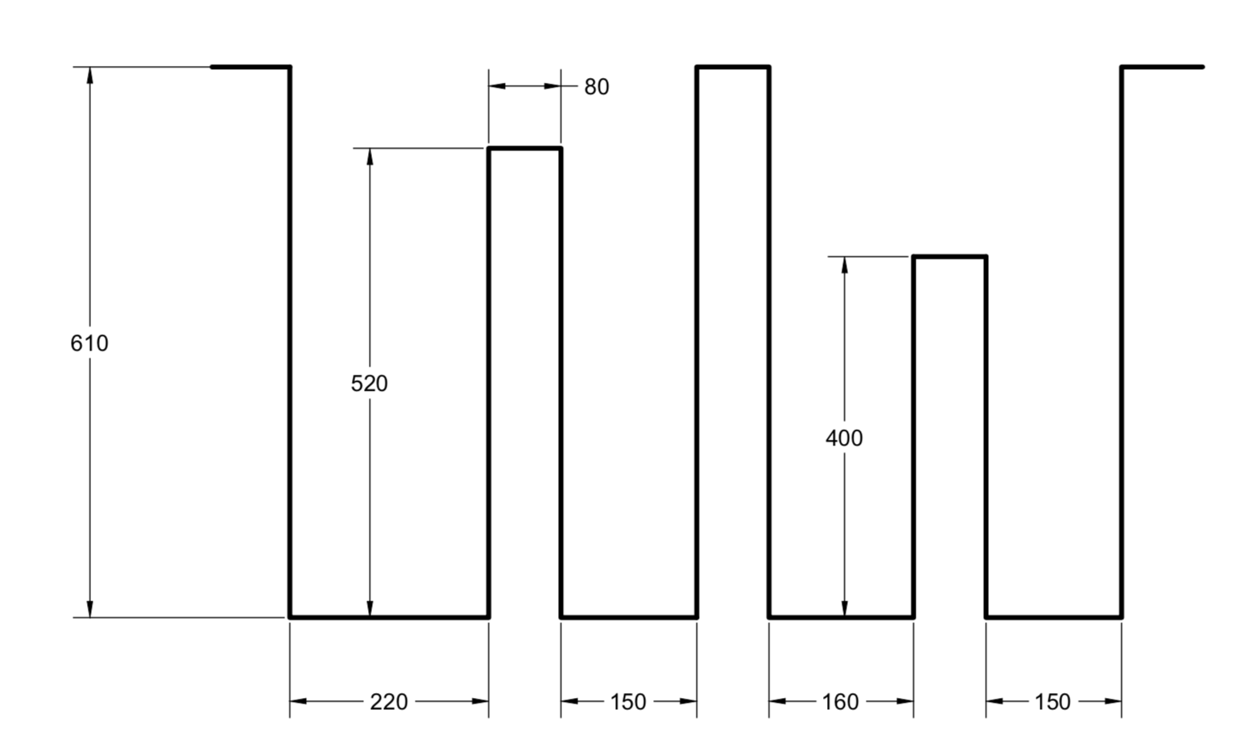
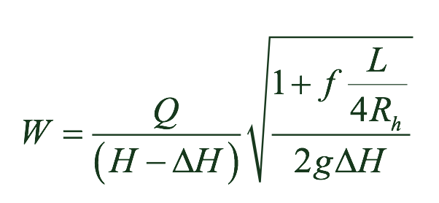
Design Algorithm--Inlet Channels
Length of the channels
Headloss of the Inlet channel pre weir
Width of the Inlet channel pre weir (surface elevation change)
Height of the inlet channels
Width of the inlet channel post weir
Select drain pipe

Slide 8
Design Algorithm--Exit Channels
Height of the exit weir
Width of the Exit channel pre weir
Width of the exit channel post weir
Width of the drain box

Slide 9
Conclusion
Total width
<--->
Construction Cost
Table 1.1 Total Width of Four Inlet Channels Based on Varying Flow Rate
Flow rate (L/s) | Number of Sed Tanks | Total Width (cm)
24 | 4 | 92.77 cm
36 | 6 | 109.3 cm
60 | 6 | 128.3 cm
Expansion recommended!
Notes:
So ideally we want the design to be able to handle the flow rate as high as 60 L/s, but if the cost is too high, the design would not be feasible for local people. Here we assume that the construction cost is proportional to the total width of the four channels, and if we look at the results we get from our codes that...

Slide 10
Thanks!

